Slide 1
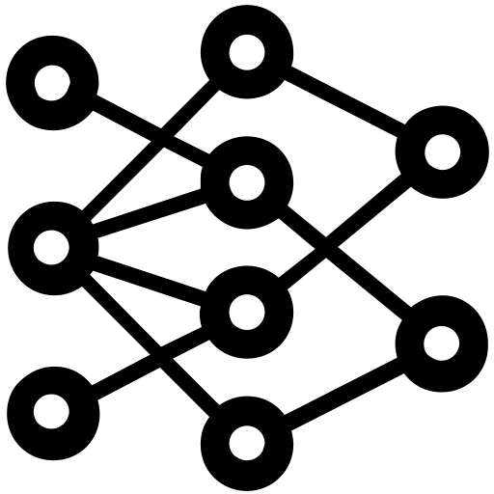




System Architecture
DL-based Method
Triplet
Semantic
Inference
Detection
Model
Training
Provenance Graph Builder
Triplets
Embeddings
FFNN
Windows
Audit Logs
Rule-based Method
Triplets / Custom Field Map / Valid Rules
Provenance Graph
registry:
attr:
- OOO: src_ooo - XXX: dst_xxx
relation:
network:
…
Valid Rule
Filter
Multi-process Matcher
selection:
- ZZZ: ^A.*B$
filter:
- XXX: ^(?=.*H)(?=.*I).*$
Triplets
selection:
- ZZZ: ^A.*B$
filter:
- XXX: ^(?=.*H)(?=.*I).*$
Rule
Converter
selection:
- ZZZ: ^A.*B$
filter:
- XXX: ^(?=.*H)(?=.*I).*$
selection:
- ZZZ: ^A.*B$
filter:
- XXX: ^(?=.*H)(?=.*I).*$
Benign
Sigma Rule
(Human readable)
Rule Database
(Machine readable)
T1111
T2222
T1070.005
Technique
Graph
Reconstruction
A Technique Graph
(T1070.005)
Triplets with Technique Label
Notes:
Windows Audit Logs: 有 benign / Attack 的 label
DL Anomaly Detector
Rule Matching Engine 裡面的小模組才是重點，要畫出來

Slide 2
20230705 討論事項
Remove Sigma from system architecture. Sigma should be a baseline and move it to experiment section in my thesis.
Remove the concept of provenance graph from my thesis. Focus on detecting technique on one single event.
New system architecture：
Module1. Synthesize Audit Log
如何模擬出含 attack 和 benign 的 log
Module2. Embedding Function
TransX, Rescal…
Module3. Detection Model
GNN, LSTM…

Slide 3


System Architecture
Module2.
Synthesize Audit Log
Module1.
Synthesize Audit Log
Windows
Audit Logs

